Slide 1
Inspired by DOS
Optimizing the GNU/Linux CLI
Joel Maxuel
First Draft

Slide 2
Topics
A lexicon of things to come
A history of ... “Why?”
Battle of the terminals
The joy in what’s common
Installation
Show and tell
Resources

Slide 3
Terminology Used
DOS – Disk Operating System, a straightforward yet powerful (due to compatibility of addons) shell – the most common being Microsoft’s MS-DOS targeted toward productivity users in the 1980’s and 1990’s
Bash – The default shell/terminal in GNU/Linux
fish – An alternative shell that can be installed/used
Git – A content revision system, used for social coding
GNU/Linux – A free (as in freedom) operating system that allows for granular customization, diversity, and otherwise total control of the experience over the big two competitors (MS Windows and Apple MacOS)

Slide 4
Introduction
Started off with DOS 5.0 and Windows 3.1 back before Windows 95 “ruined everything”
Have used GNU/Linux since 1998
Recently gained an interest in DOS again
Trialling Caldera DR-DOS 7.03 in a Virtual Machine
Sifting through hundreds of gifted batch files
All to apply existing knowledge to another platform

Slide 5
Bash or fish?
Each have their qualities and I personally use both
For compiling, or doing the “status quo”: Bash is king
For being helpful in what you are trying to accomplish, generally fish is leaps and bounds ahead
For scripting, Bash is often succinct in their intent, leaving little room for alternative interpretation, whereas fish can be detail orientated, but allow for a variety of outcomes.

Slide 6
Bash or fish? - Code Comparison ...
fish ...
function cdb --description 'Change Directory Below command'
set -l all_dirs (find -type d -name "$argv[1]" -not -path '*/\.*' -prune)
if not set -q all_dirs[1]
echo (_ 'No matches found.')
return 0
end
set -l letters a b c d e f g h i j k l m n o p q r s t u v w x y z
set -l dirc (count $all_dirs)
if test $dirc -gt (count $letters)
set -l msg (_ 'Too many results. Truncating.')
printf "$msg\n"
set -l msg (_ 'There are %s unique dirs in your results but I can only handle %s')
printf "$msg\n" $dirc (count $letters)
set dirc (count $letters)
end
# Automatically go to directory if only one result
if test $dirc -eq 1
cd $all_dirs[1]
return 0
end
# Print the matching directories.
for i in (seq 1 $dirc)
set -l dir $all_dirs[$i]
set -l label_color normal
set -q fish_color_cwd; and set label_color $fish_color_cwd
set -l dir_color_reset (set_color normal)
set -l dir_color
printf '%s %s %2d) %s %s%s%s\n' (set_color $label_color) $letters[$i] $i (set_color normal) $dir_color $dir $dir_color_reset
end
# Ask the user which directory from their results they want to cd to.
set -l msg (_ 'Select directory by letter or number: ')
read -l -p "echo '$msg'" choice
if test "$choice" = ""
return 0
else if string match -q -r '^[a-z]$' $choice
# Convert the letter to an index number.
set choice (contains -i $choice $letters)
end
set -l msg (_ 'Error: expected a number between 1 and %d or letter in that range, got "%s"')
if string match -q -r '^\d+$' $choice
if test $choice -ge 1 -a $choice -le $dirc
cd $all_dirs[$choice]
return
else
printf "$msg\n" $dirc $choice
return 1
end
else
printf "$msg\n" $dirc $choice
return 1
end
end
Versus Bash ...
function cdb() {
    select dir in $(find -type d -name "$1" -not -path '*/\.*' -prune);
  do
    command cd "${dir}" && break;
  done
}

Slide 7
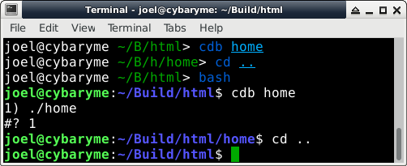
Bash or fish? - ... Versus Output
Both scripts present menu if multiple results
Only fish will proceed if just one result

Slide 8
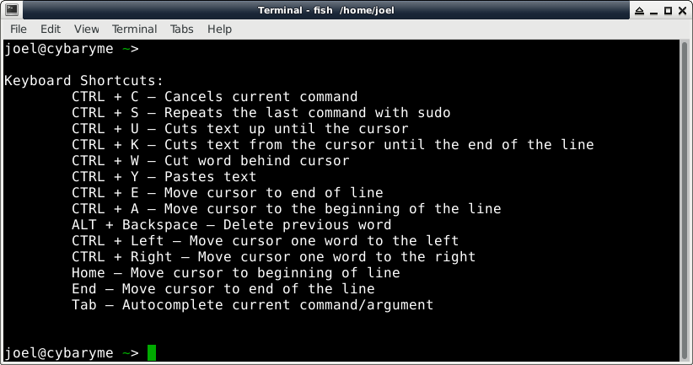
A Common Goal
Many of the keyboard shortcuts remain the same
Some shortcuts in list have been added (one or both)

Slide 9
Introduction (Part Two)
While creating (or adapting) the optimizations, I started to collect them with Git so they can be shared
Early stages stored on a private GitLab instance, later on made public with GitHub
Also created resource files (readme, installers) to help ease the effort needed to access the tools
Examples of functions added include inspiration mostly from DOS batch files (mkd – make directory then enter it), but can also include time saving tasks to simplify the collection process (editadd – edit file then mark for addition to next git commit)

Slide 10
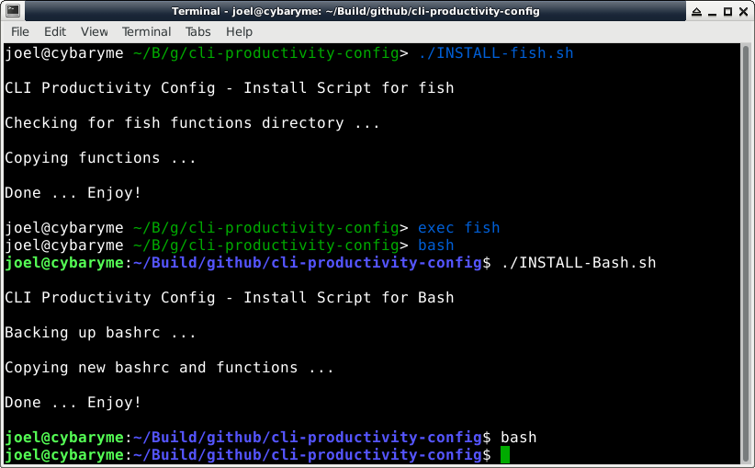
A Simple Install

Slide 11
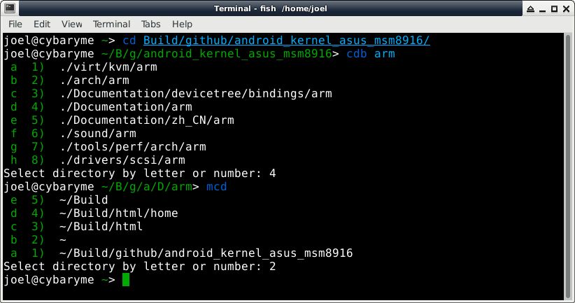
Demonstration

Slide 12
Useful Links / Thanks
The missing fish shell tutorial:
https://geowarin.github.io/the-missing-fish-shell-tutorial.html
Become a Command Line Ninja:
http://lifehacker.com/5743814/become-a-command-line-ninja-with-these-time-saving-shortcuts
These customizations:
https://github.com/joelmaxuel/cli-productivity-config
Thanks to all those I have mentioned in my commit messages, as well as to Richard Bonner for all the DOS information, explanation, and support.

